Slide 1
Enhancing Confidence of the vGOAL Interpreter Using SAT Solving
DistriNet Research Group
Yi Yang, Tom Holvoet

Slide 2
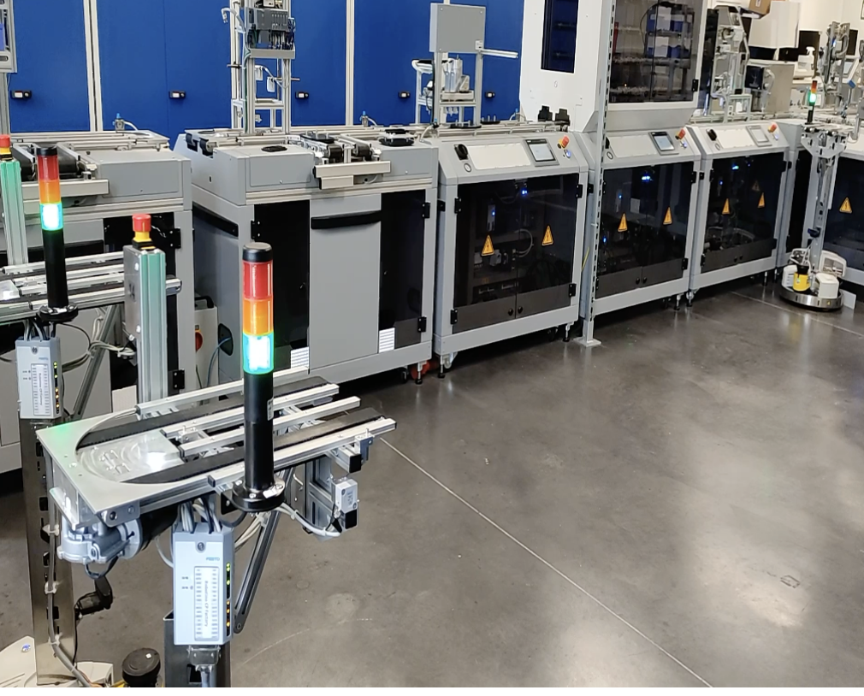
Motivating Example
Safe Autonomous logistic system
Safe high-level decision-making
Move
Pick up
Drop off
Charge
Safe low-level code execution
Notes:
Concerns: task completion, error handling, efficiency, collision among agents and obstacles

Slide 3
vGOAL
Language
Choose GOAL as the basis
Verifiable GOAL
Restricted first-order logic
Interpreter
Semantics of vGOAL
An agent-based decision-making component
How to enhance confidence?

Slide 4
Related Work
Formal Verification of APL Programs
Model Checking of APL Programs
AgentSpeak [1]
Gwendolen [2]
GOAL [3]
Verifying the implementation of the APL Interpreters?
Significant efforts [4]
Bordini, R.H., Fisher, M., Pardavila, C., Wooldridge, M.: Model checking AgentS- peak. In: Proceedings of the second international joint conference on Autonomous agents and multiagent systems. pp. 409–416 (2003)
Dennis, L.A., Fisher, M., Webster, M.P., Bordini, R.H.: Model checking agent programming languages. Automated software engineering 19(1), 5–63 (2012)
Jongmans,S.S.T.,Hindriks,K.V.,VanRiemsdijk,M.B.:Modelcheckingagentpro- grams by using the program interpreter. In: Computational Logic in Multi-Agent Systems: 11th International Workshop, CLIMA XI, Lisbon, Portugal, August 16- 17, 2010. Proceedings 11. pp. 219–237. Springer (2010)
Dennis, L.A., Fisher, M., Webster, M.P., Bordini, R.H.: Model checking agent programming languages. Automated software engineering 19(1), 5–63 (2012)

Slide 5
Implementation Correctness of the vGOAL Interpreter
How to enhance confidence?
Show the generation process always generates the correct result. (Program Verification) [1]
Significant efforts to specify pre- and postconditions of thousands of code lines
Show the generated result is the correct result.
Possible for the core component of vGOAL interpreter
[1] Dennis, L.A., Fisher, M., Webster, M.P., Bordini, R.H.: Model checking agent programming languages. Automated software engineering 19(1), 5–63 (2012)
Notes:
The generated model is the minimal model.

Slide 6
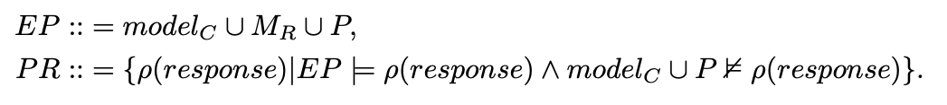
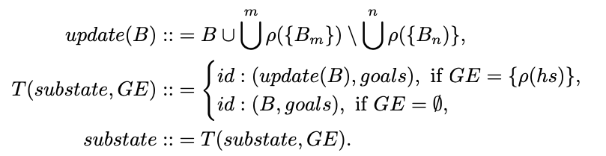
Operational Semantics
Substate Property Generation
Minimal Model Generation
Enabled Constraint Generation
Enabled Action Generation
Enabled Sent Message Generation
Functions
Event Processing
Communication

Slide 7
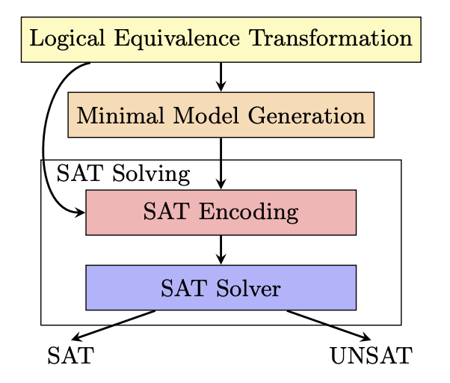
SAT-Solving Integration
SAT Encoding
Encode the inputs and outputs of the minimal model generation into a CNF formula
SAT Solver
PySAT: a simple interface to numerous state-of-the-art SAT solvers. [1]
[1] Ignatiev, A., Morgado, A., Marques-Silva, J.: PySAT: A Python toolkit for proto- typing with SAT oracles. In: SAT. pp. 428–437 (2018)

Slide 8
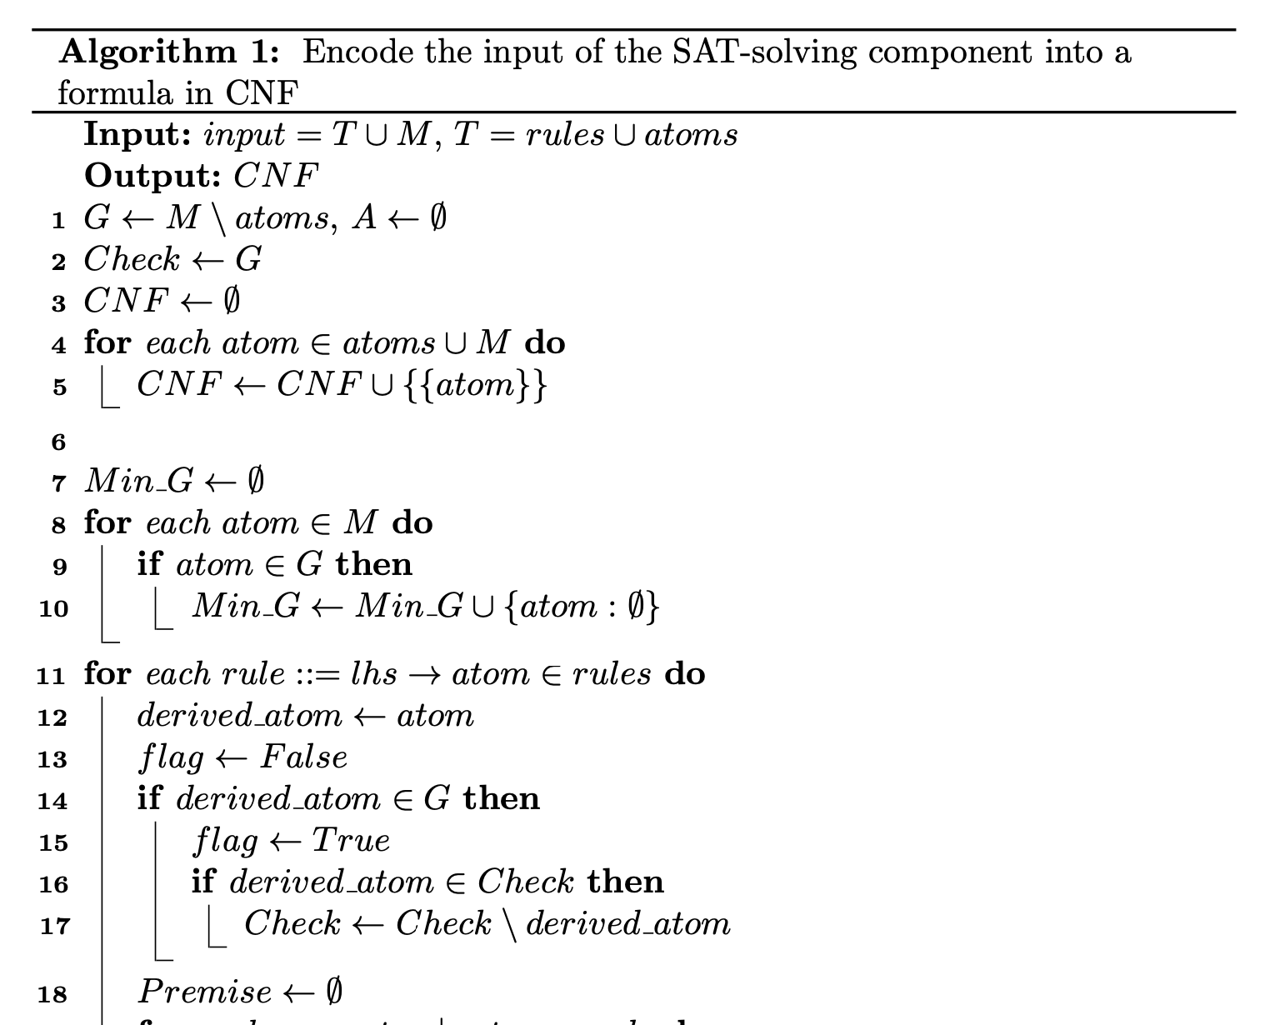
SAT-Encoding Algorithm

Slide 9
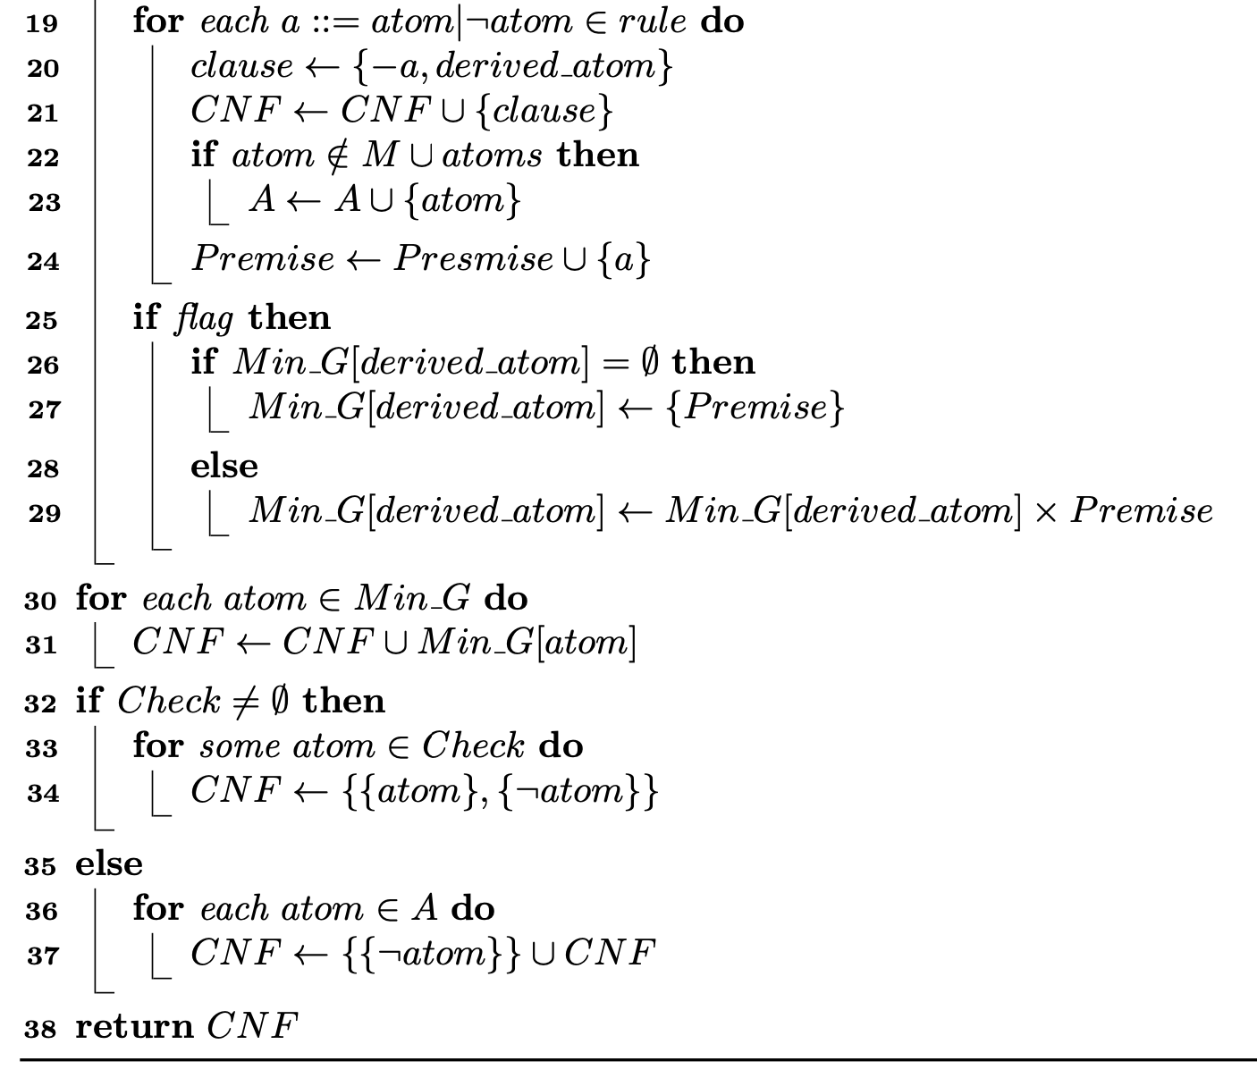
SAT-Encoding Algorithm

Slide 10
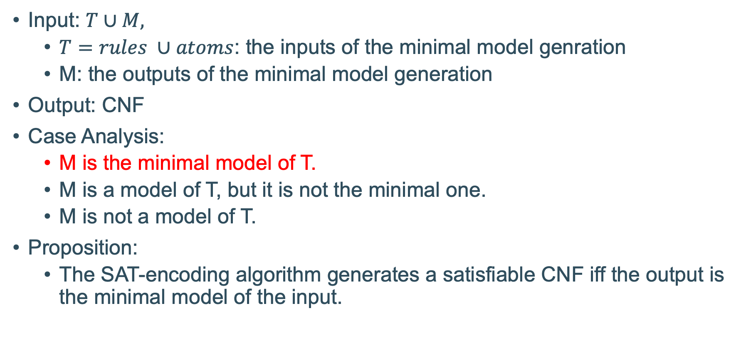
SAT-Encoding Algorithm
Input: $T∪M,$
$T=rules ∪atoms$: the inputs of the minimal model genration
M: the outputs of the minimal model generation
Output: CNF
Case Analysis:
M is the minimal model of T.
M is a model of T, but it is not the minimal one.
M is not a model of T.
Proposition:
The SAT-encoding algorithm generates a satisfiable CNF iff the output is the minimal model of the input.

Slide 11
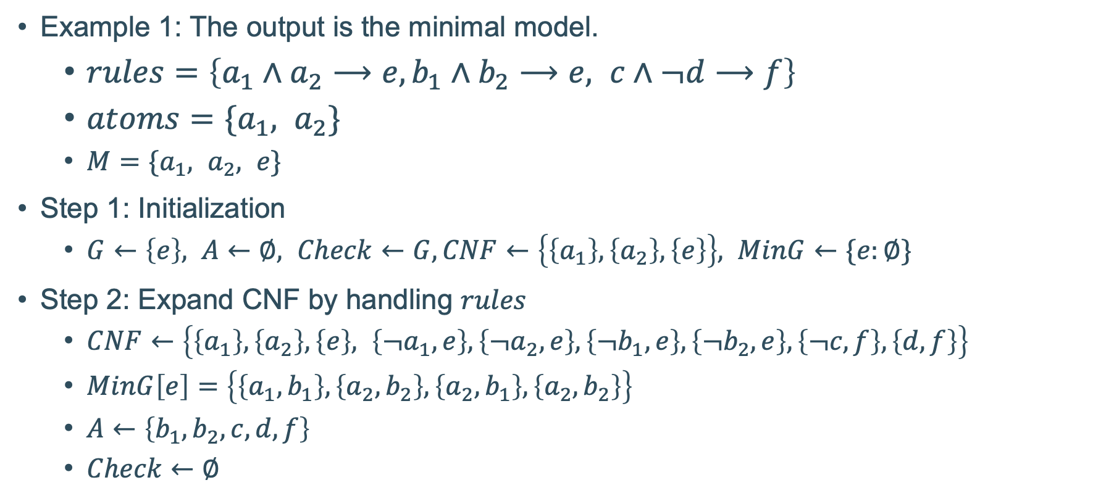
SAT-Encoding Algorithm
Example 1: The output is the minimal model.
$rules=\left\{a_{1}∧a_{2}⟶e,b_{1}∧b_{2}⟶e, c∧¬d⟶f\right\}$
$atoms=\{a_{1}, a_{2}\}$
$M=\{a_{1}, a_{2}, e\}$
Step 1: Initialization
$G←\left\{e\right\}, A←∅, Check←G, CNF←\left\{\left\{a_{1}\right\}, \left\{a_{2}\right\}, \left\{e\right\}\right\}, MinG←\{e:∅\}$
Step 2: Expand CNF by handling $rules$
$CNF←\left\{\left\{a_{1}\right\},\left\{a_{2}\right\},\left\{e\right\}, \left\{¬a_{1}, e\right\},\left\{¬a_{2}, e\right\},\left\{¬b_{1}, e\right\},\left\{¬b_{2}, e\right\},\left\{¬c, f\right\},\left\{d, f\right\}\right\}$
$MinG\left[e\right]=\left\{\left\{a_{1},b_{1}\right\},\left\{a_{2},b_{2}\right\},\left\{a_{2},b_{1}\right\},\left\{a_{2},b_{2}\right\}\right\}$
$A←\left\{b_{1}, b_{2}, c, d, f\right\}$
$Check←∅$

Slide 12
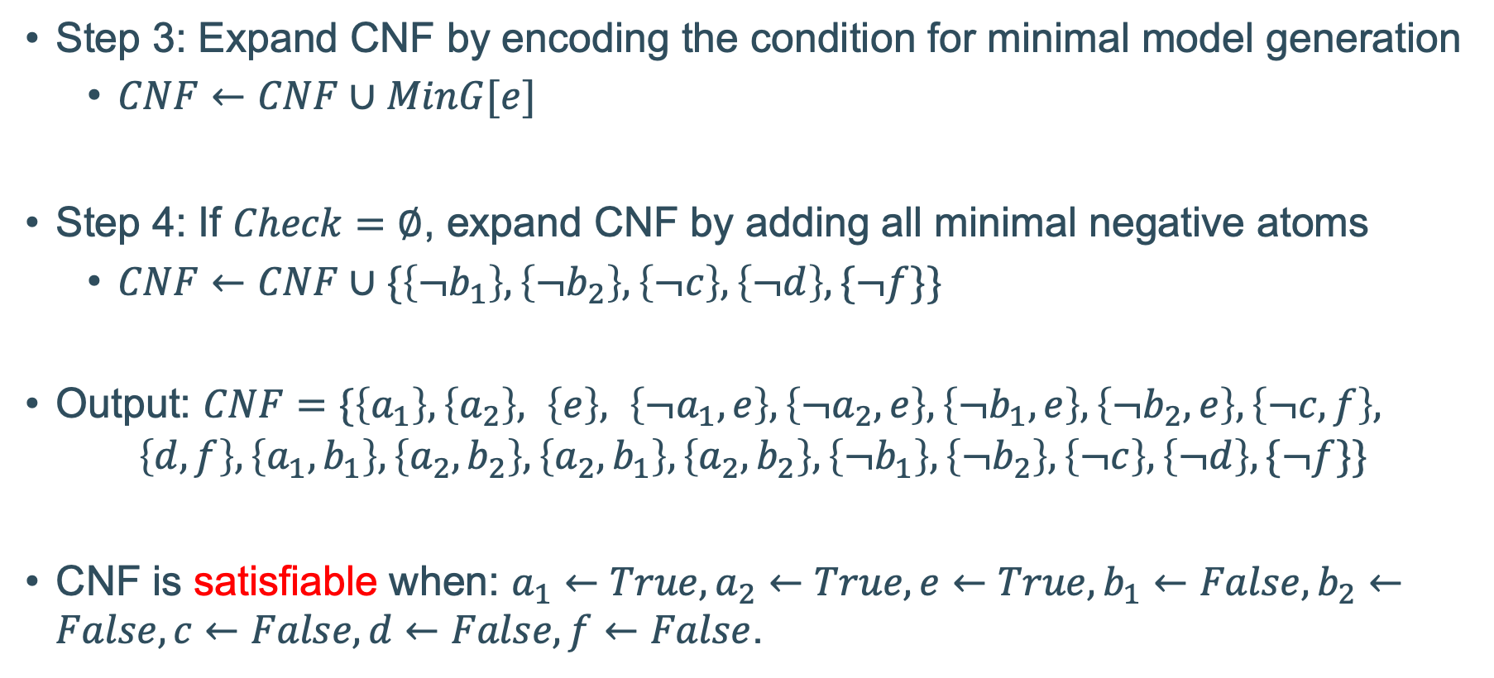
SAT-Encoding Algorithm
Step 3: Expand CNF by encoding the condition for minimal model generation
$CNF←CNF∪MinG[e]$
Step 4: If $Check=∅$, expand CNF by adding all minimal negative atoms
$CNF←CNF∪\{\left\{¬b_{1}\right\}, \left\{¬b_{2}\right\},\left\{¬c\right\}, \left\{¬d\right\},\{¬f\}\}$
Output: $CNF=\{\left\{a_{1}\right\},\left\{a_{2}\right\}, \left\{e\right\}, \left\{¬a_{1}, e\right\},\left\{¬a_{2}, e\right\},\left\{¬b_{1}, e\right\},\left\{¬b_{2}, e\right\},\left\{¬c, f\right\},$
$$\left\{d, f\right\},\left\{a_{1},b_{1}\right\},\left\{a_{2},b_{2}\right\},\left\{a_{2},b_{1}\right\},\left\{a_{2},b_{2}\right\}, \left\{¬b_{1}\right\}, \left\{¬b_{2}\right\},\left\{¬c\right\}, \left\{¬d\right\},\{¬f\}\}$$
CNF is satisfiable when: $a_{1}←True, a_{2}←True, e←True, b_{1}←False, b_{2}←False, c←False, d←False, f←False$.

Slide 13
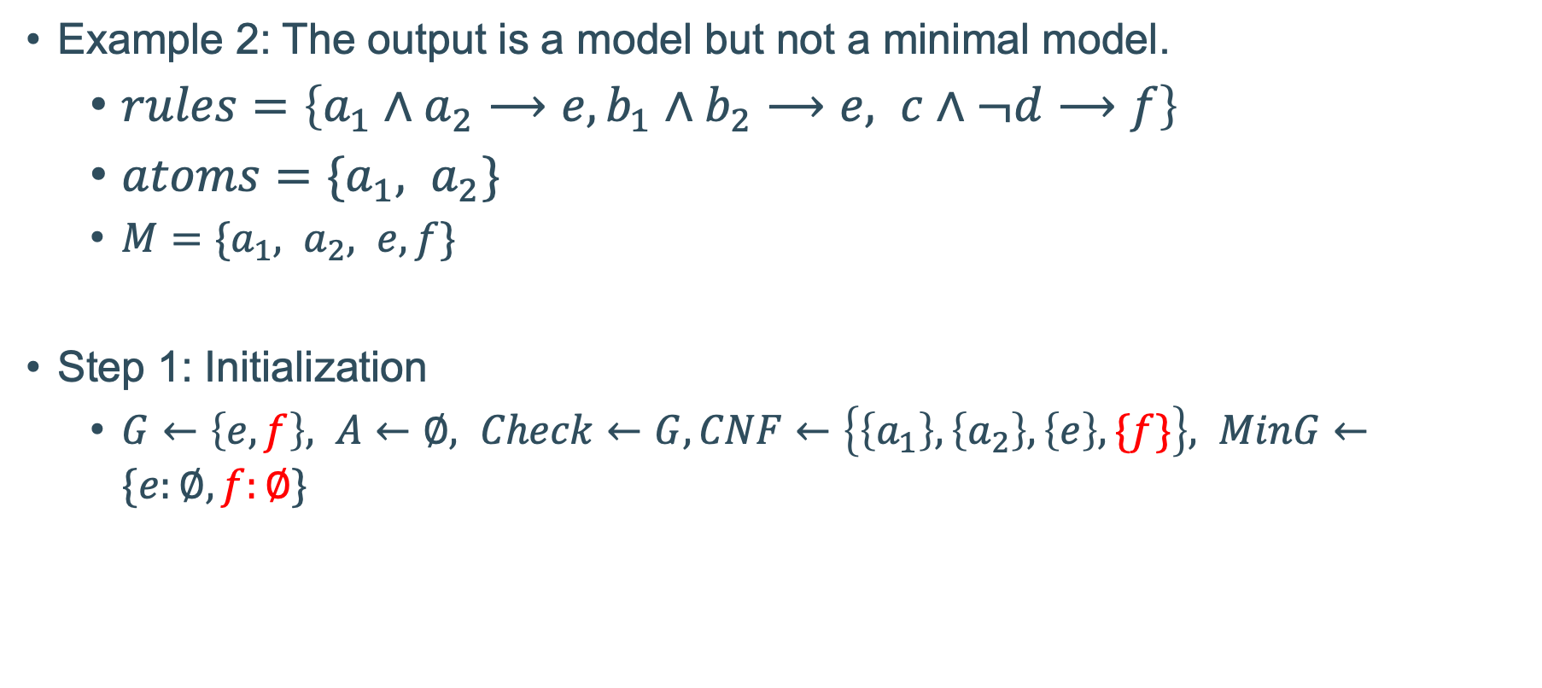
SAT-Encoding Algorithm
Example 2: The output is a model but not a minimal model.
$rules=\left\{a_{1}∧a_{2}⟶e,b_{1}∧b_{2}⟶e, c∧¬d⟶f\right\}$
$atoms=\{a_{1}, a_{2}\}$
$M=\{a_{1}, a_{2}, e,f\}$
Step 1: Initialization
$G←\left\{e,f\right\}, A←∅, Check←G, CNF←\left\{\left\{a_{1}\right\}, \left\{a_{2}\right\}, \left\{e\right\}, \{f\}\right\}, MinG←\{e:∅,f:∅\}$

Slide 14
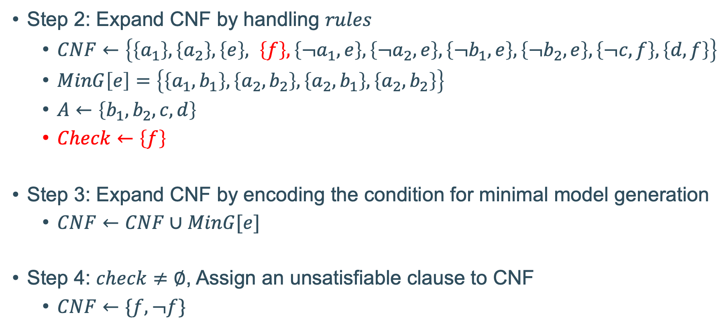
SAT-Encoding Algorithm
Step 2: Expand CNF by handling $rules$
$CNF←\left\{\left\{a_{1}\right\},\left\{a_{2}\right\},\left\{e\right\}, \left\{f\right\}, \left\{¬a_{1}, e\right\},\left\{¬a_{2}, e\right\},\left\{¬b_{1}, e\right\},\left\{¬b_{2}, e\right\},\left\{¬c, f\right\},\left\{d, f\right\}\right\}$
$MinG\left[e\right]=\left\{\left\{a_{1},b_{1}\right\},\left\{a_{2},b_{2}\right\},\left\{a_{2},b_{1}\right\},\left\{a_{2},b_{2}\right\}\right\}$
$A←\left\{b_{1}, b_{2}, c, d\right\}$
$Check←\left\{f\right\}$
Step 3: Expand CNF by encoding the condition for minimal model generation
$CNF←CNF∪MinG[e]$
Step 4: $check≠∅$, Assign an unsatisfiable clause to CNF
$CNF←\{f, ¬f\}$

Slide 15
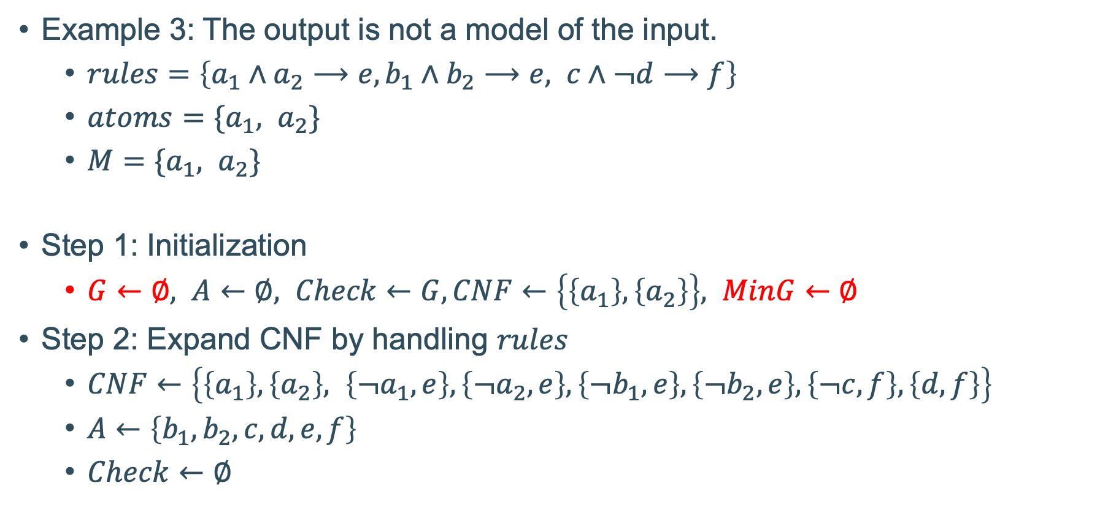
SAT-Encoding Algorithm
Example 3: The output is not a model of the input.
$rules=\left\{a_{1}∧a_{2}⟶e,b_{1}∧b_{2}⟶e, c∧¬d⟶f\right\}$
$atoms=\{a_{1}, a_{2}\}$
$M=\{a_{1}, a_{2}\}$
Step 1: Initialization
$G←∅, A←∅, Check←G, CNF←\left\{\left\{a_{1}\right\}, \left\{a_{2}\right\}\right\}, MinG←∅$
Step 2: Expand CNF by handling $rules$
$CNF←\left\{\left\{a_{1}\right\},\left\{a_{2}\right\}, \left\{¬a_{1}, e\right\},\left\{¬a_{2}, e\right\},\left\{¬b_{1}, e\right\},\left\{¬b_{2}, e\right\},\left\{¬c, f\right\},\left\{d, f\right\}\right\}$
$A←\left\{b_{1}, b_{2}, c, d, e,f\right\}$
$Check←∅$

Slide 16
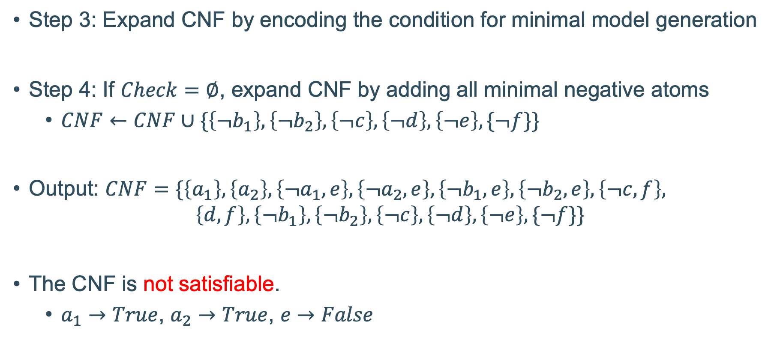
SAT-Encoding Algorithm
Step 3: Expand CNF by encoding the condition for minimal model generation
Step 4: If $Check=∅$, expand CNF by adding all minimal negative atoms
$CNF←CNF∪\{\left\{¬b_{1}\right\}, \left\{¬b_{2}\right\},\left\{¬c\right\}, \left\{¬d\right\},\left\{¬e\right\},\{¬f\}\}$
Output: $CNF=\{\left\{a_{1}\right\},\left\{a_{2}\right\}, \left\{¬a_{1}, e\right\},\left\{¬a_{2}, e\right\},\left\{¬b_{1}, e\right\},\left\{¬b_{2}, e\right\},\left\{¬c, f\right\},$
$$\left\{d, f\right\}, \left\{¬b_{1}\right\}, \left\{¬b_{2}\right\},\left\{¬c\right\}, \left\{¬d\right\},\left\{¬e\right\},\{¬f\}\}$$
The CNF is not satisfiable.
$a_{1}→True$, $a_{2}→True$, $e→False$

Slide 17
Case Study
Compare the performance of the two versions of the vGOAL Interpreter
Experiments
One error-free run
One run including a non-fatal error
One run including a fatal error

Slide 18
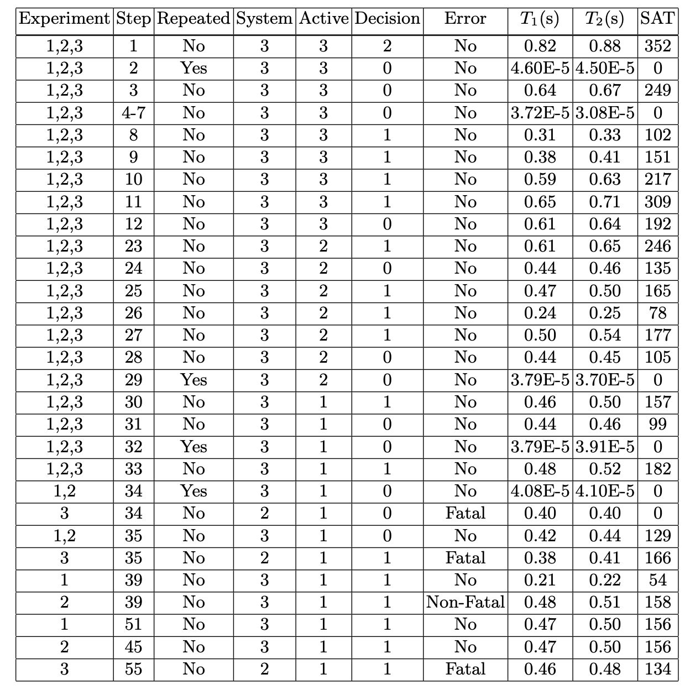
Case Study
Compare the performance of the two versions of the vGOAL Interpreter
Experiments
One error-free run
One run including a non-fatal error
One run including a fatal error

Slide 19
Case Study
Overhead for SAT-solving
At most 0.06s in experiments
positively linear to
the number of calls made to SAT-solving
0 when handling repeated sensor information.
Decision | Time 1 (s) | Time 2 (s) | Calls of SAT-solving | Overhead (s)
1 | 0.82 | 0.88 | 352 | 0.06
2 | 4.60 E-5 | 4.50 E-5 | 0 | 0
3 | 0.64 | 0.67 | 249 | 0.03
4-7 | 3.72 E-5 | 3.08 E-5 | 0 | 0
8 | 0.31 | 0.33 | 102 | 0.02
9 | 0.38 | 0.41 | 151 | 0.03
10 | 0.59 | 0.63 | 217 | 0.04
Notes:
T1: the time taken for the vGOAL interpreter without SAT-solving
T2: the time taken for the vGOAL interpreter with SAT-solving

Slide 20
Conclusion
Challenges
Complexity
Guaranteed assurance
Efficiency
Automation
Main Contribution
The SAT-solving component integrated into the vGOAL interpreter
Efficiently ensure the correctness of the core component

Slide 21
Reference
Bordini, R.H., Fisher, M., Pardavila, C., Wooldridge, M.: Model checking AgentS- peak. In: Proceedings of the second international joint conference on Autonomous agents and multiagent systems. pp. 409–416 (2003)
Dennis, L.A., Fisher, M., Webster, M.P., Bordini, R.H.: Model checking agent programming languages. Automated software engineering 19(1), 5–63 (2012)
Jongmans,S.S.T.,Hindriks,K.V.,VanRiemsdijk,M.B.:Modelcheckingagentpro- grams by using the program interpreter. In: Computational Logic in Multi-Agent Systems: 11th International Workshop, CLIMA XI, Lisbon, Portugal, August 16- 17, 2010. Proceedings 11. pp. 219–237. Springer (2010)
Dennis, L.A., Fisher, M., Webster, M.P., Bordini, R.H.: Model checking agent programming languages. Automated software engineering 19(1), 5–63 (2012)
Ignatiev, A., Morgado, A., Marques-Silva, J.: PySAT: A Python toolkit for proto- typing with SAT oracles. In: SAT. pp. 428–437 (2018)

